Slide 1

Pairwise Longest Common Subsequence for Gene Sequences
Analysis of 181 Gene Sequences

Slide 2

Problem Statement
Compute the pairwise LCS for 181 sequences.
Record computational time.
Present results in two square tables (181x181).

Slide 3

Objectives
Compute the LCS for each pair of gene sequences.
Measure computational time for each comparison.
Create LCS length and time tables.
Analyze performance, challenges, and optimizations.

Slide 4

Methodology
Data Input: 181 sequences from a CSV file.
Approach:
Use dynamic programming to compute LCS efficiently.
Measure time using the chrono library.
Tools:
C++ Programming

Slide 5
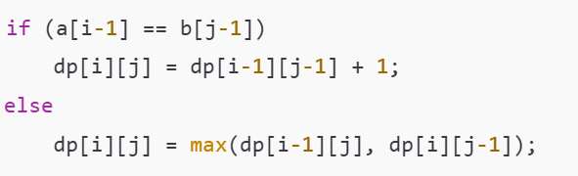
Dynamic Programming for LCS
Algorithm Overview

Slide 6
Dynamic Programming for LCS
Time Complexity
O(m×n), where m and n are lengths of the sequences.

Slide 7
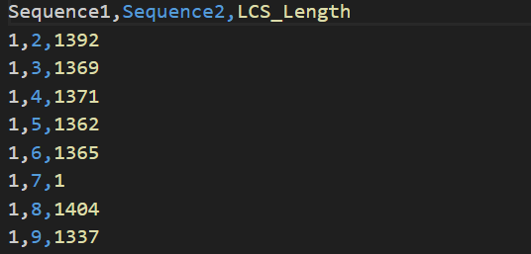
Results – LCS Table

Slide 8
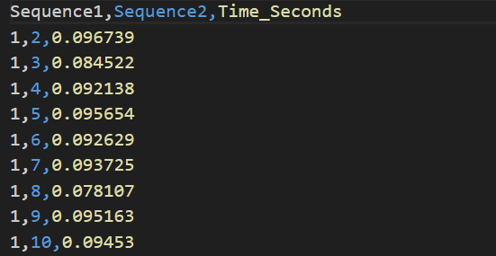
Results – Computational Time

Slide 9
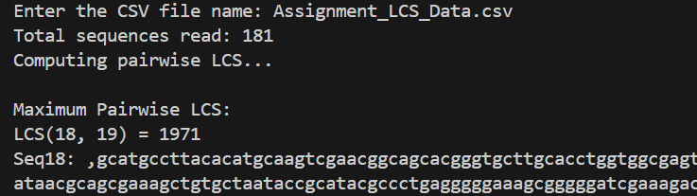
Results – Overall result

Slide 10
Challenges
Data Cleaning
Scalability
Computational Bottlenecks:

Slide 11
Optimizations
Memoization:
Parallel Processing:
Space Optimization:

Slide 12
Conclusion
Key Achievements:
Generated LCS length table for all 181 gene sequences.
Recorded computational time for each pair.
Identified sequences with maximum similarity (LCS Length: 1971).

Slide 13
Good bye

